Slide 1
USEFUL JAPANESE DICTIONARY FOR VIETNAMESE
Supervisor: Nguyễn Văn Sang
Lê Đình Nam se02316
Phạm Thị Minh se02300
Phạm Tiến Đạt se02336
Nguyễn Ngọc Tuấn se02189

Slide 2
Problem Definition
The Idea
System purpose/ objective
Requirements
Functionalities

Slide 3
Problem Definition
Demand of learning Japanese high
Learning online
Nowadays, the relation of Vietnam and Japan is very good, Japan market need more human resource of Vietnam in many fields, special IT.
Have a lot of Japanese training center
With technology development, there are many websites to learn Japanese with many types and languages. Moreover it requests user upgrade account to learn.
Because number of people learn Japanese is crowd, series of centers are opened but they cannot control of training quality.

Slide 4
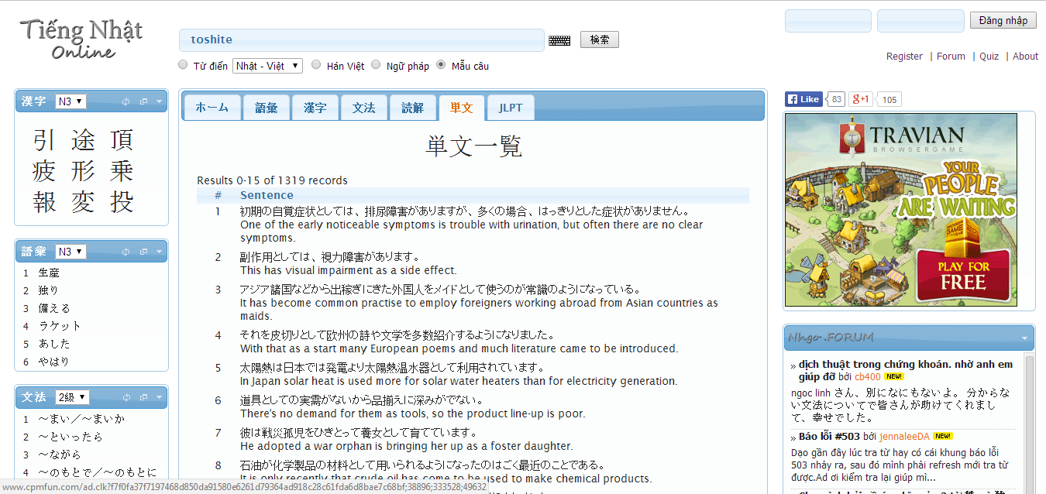
Problem Definition
With purpose is save time, many users choose study online likes a best way. But nowadays, have not website really good for Vietnamese.
Search with more option, but more words have not meaning with Vietnamese
Search Kanji, grammar
Post question
Do not support Viet-Nhat dictionary
Do not support listening, reading, conservation …

Slide 5
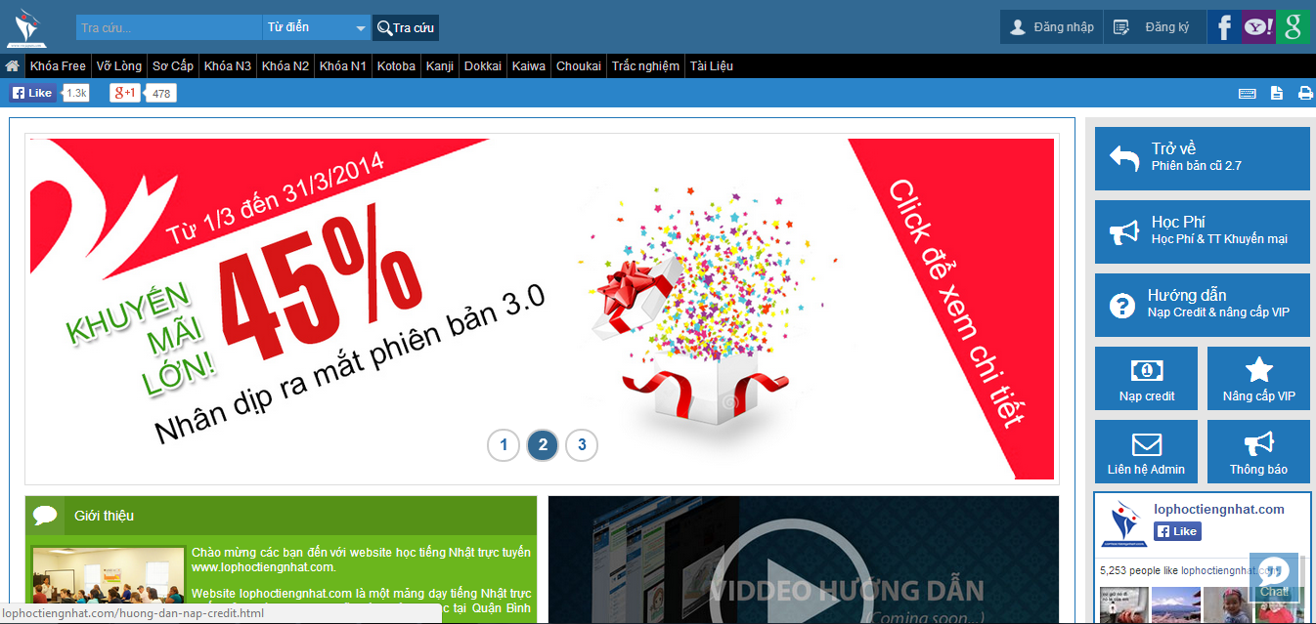
Problem Definition
Full support with listening, reading, conservation
Support search but too simple
Have to register and upgrade account to study

Slide 6



The idea
Reducing above gaps and integrating important function to help user by a best way. UJD_VN will bring to user:
User only need a laptop connect to internet, use any browser to access website
Friendly interface, easy to use by Vietnamese language
User have not to mind about upgrading account to study

Slide 7


The idea
Full of sections to user can choose, such as: reading, listening, conservation, video, review JLPT…
Specially, search function with full option to help user maximum
User can contribute opinion and data

Slide 8


Objectives
To meet requirements from FPT University, we have to complete this project, it is conditional for us to graduate.
Applying knowledge during in 4 years to complete project successfully
Studying more about: Java script, PHP, HTML, …

Slide 9
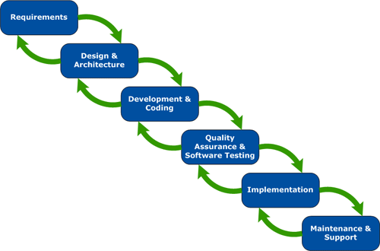


Objectives
Understanding of software development process of F-soft
Learning manage project and time
Improving soft skill and working in group

Slide 10
Functional Requirements
The system will be developed on web
User include guest and member can use functions likes:
User can filter and searching words with options: dictionary Nhat- Viet, example sentences, grammar, video, conservation, specialized japanese
User can learn with many sections: fundamental, intermediate, review JLPT,reading, conservation

Slide 11
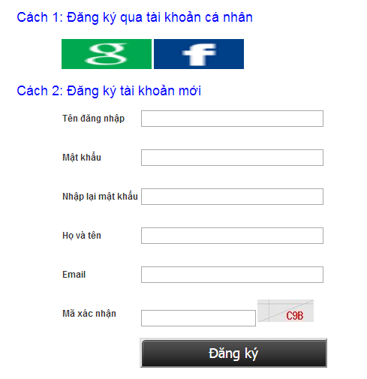
Functional Requirements
If user is guest, they can register then doing test and tracking mark in manage account

Slide 12
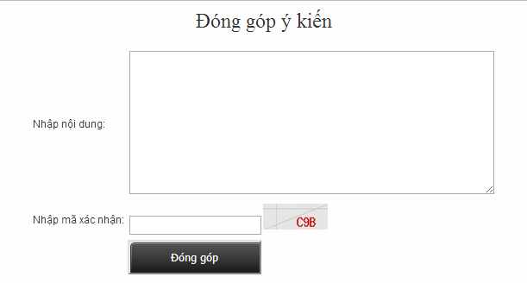
Functional Requirements
If user is member, they can log in then they can contribute data or opinion

Slide 13
Functional Requirements
Admin can manage account: edit, ban, delete member
Admin can manage database: add, edit, delete database
Responding and approving from opinion’s user

Slide 14
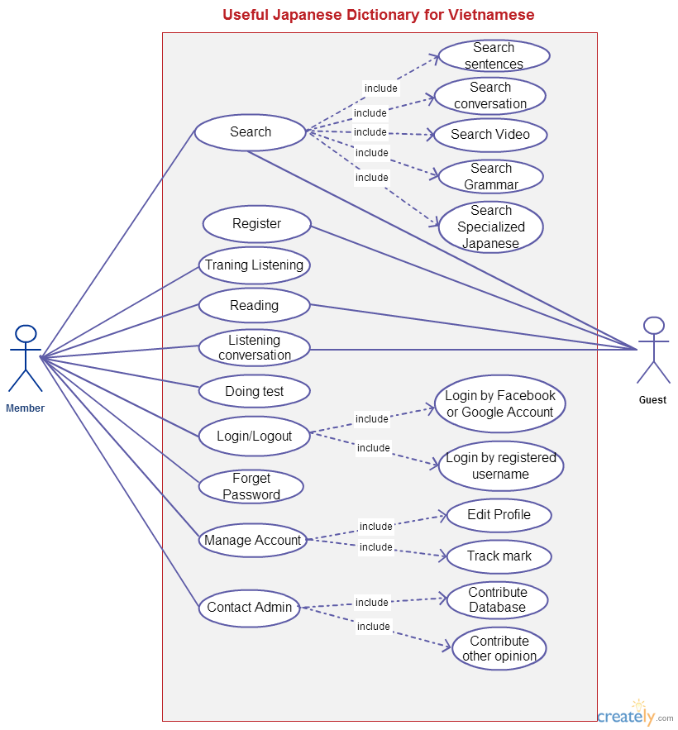
Use cases diagram

Slide 15
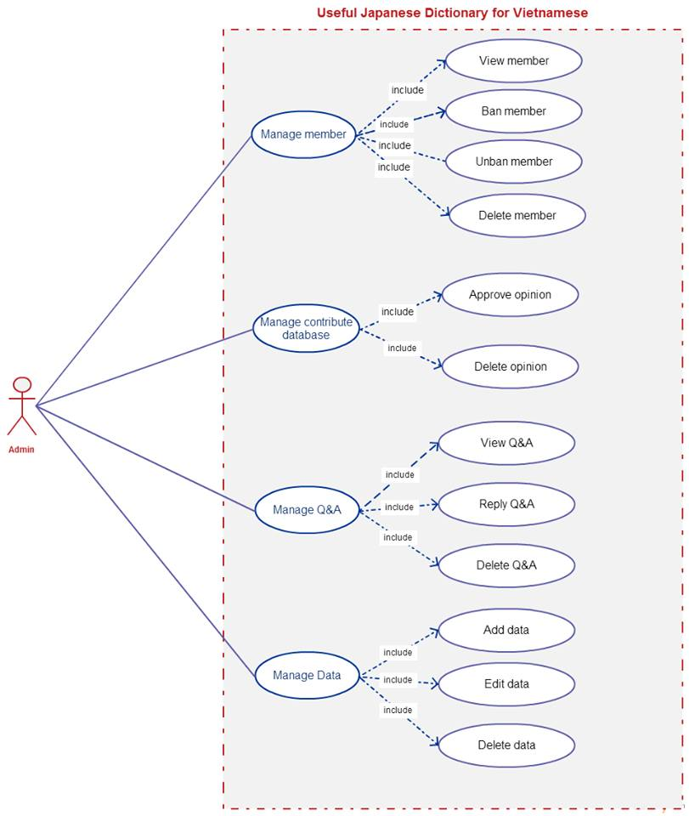
Use cases diagram

Slide 16
Non-Functional Requirements
Performance: time to response, time of processing.
Availability: hours of operation
Maintainability: architectural standards, coding standards.
Usability: friendly, interactive.
Capacity and scalability: throughput, storage and growth requirements.

Slide 17
Funtionality
User:
Search depend on section
Register account
Login, logout
Manage account: change password, forget password, tracking mark
Doing test

Slide 18
Funtionality
Training listening
Reading
Conservation
Contact admin: Send opinion, contribute database

Slide 19
Funtionality
Admin
Edit, ban, delete member
Add, edit, delete database
Response opinion’s user
Approve contribution of user

Slide 20


